Slide 1
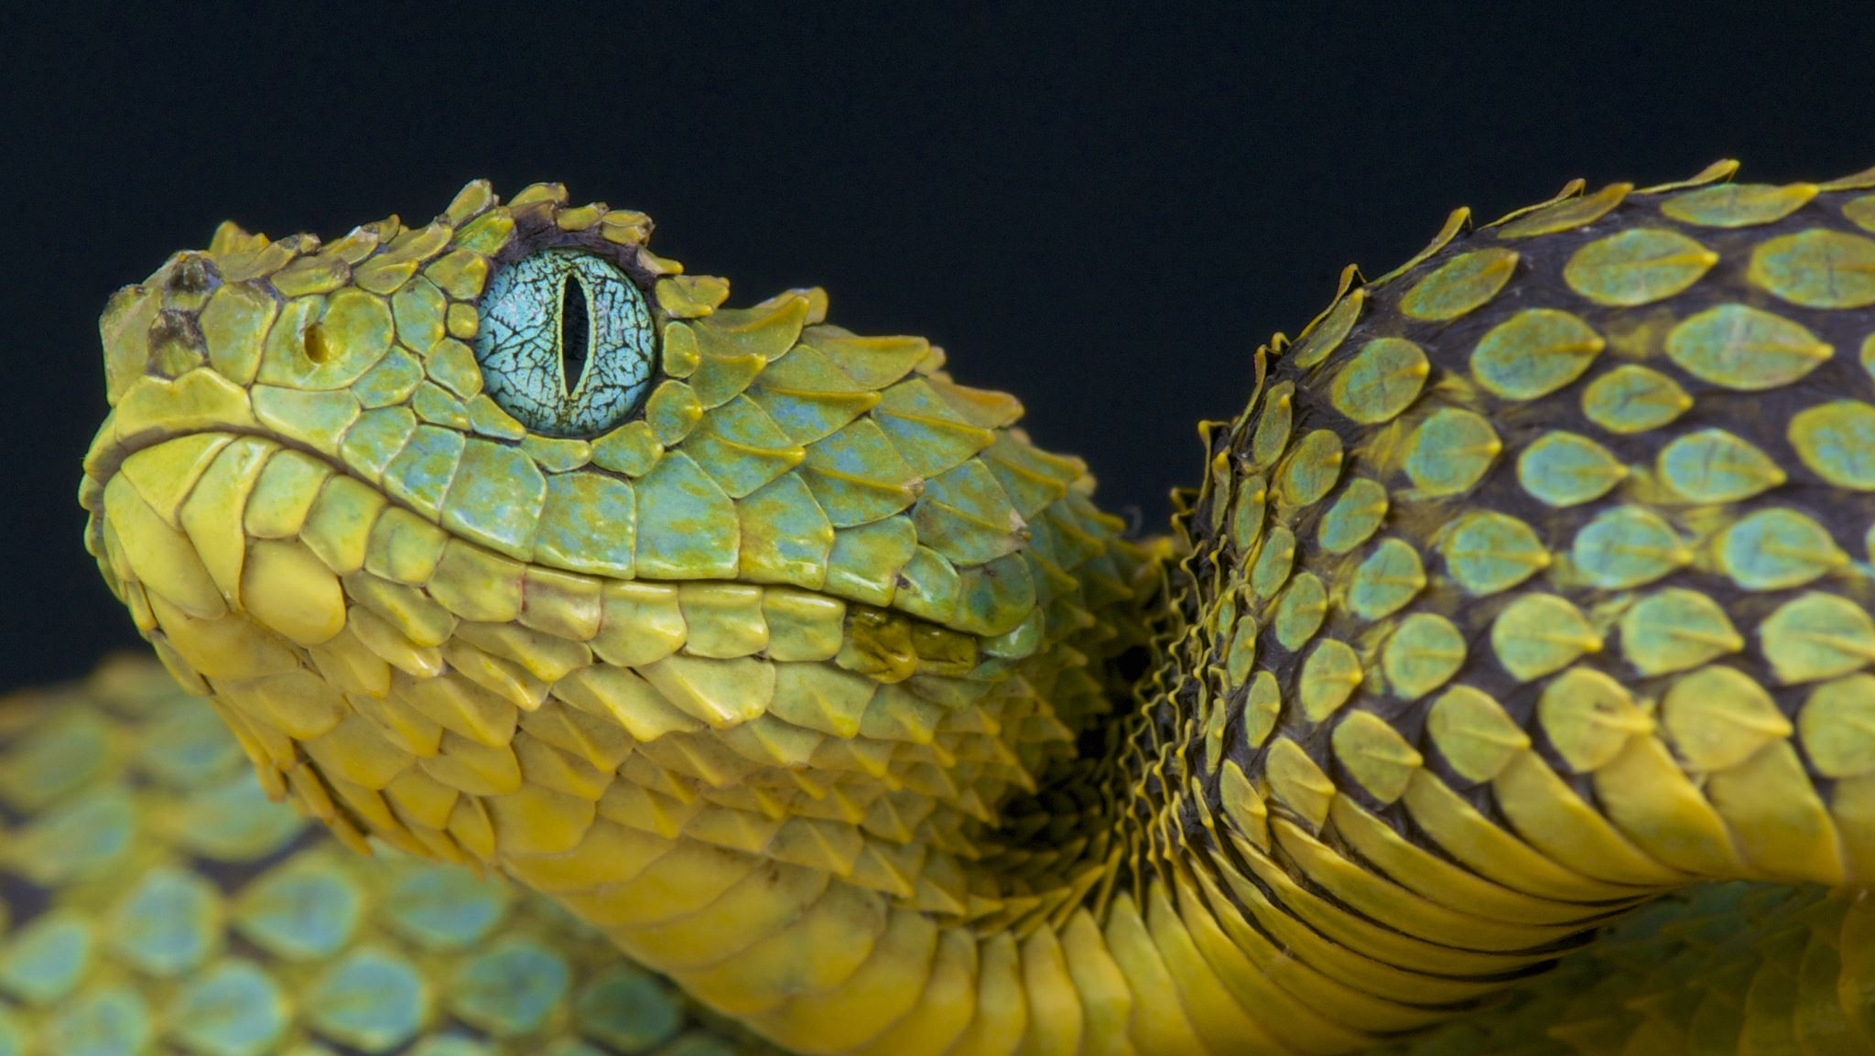
Python! Day 9
Welcome to intermediate Python!
Warm up: Number guessing game
Introduction to dictionaries

Slide 2
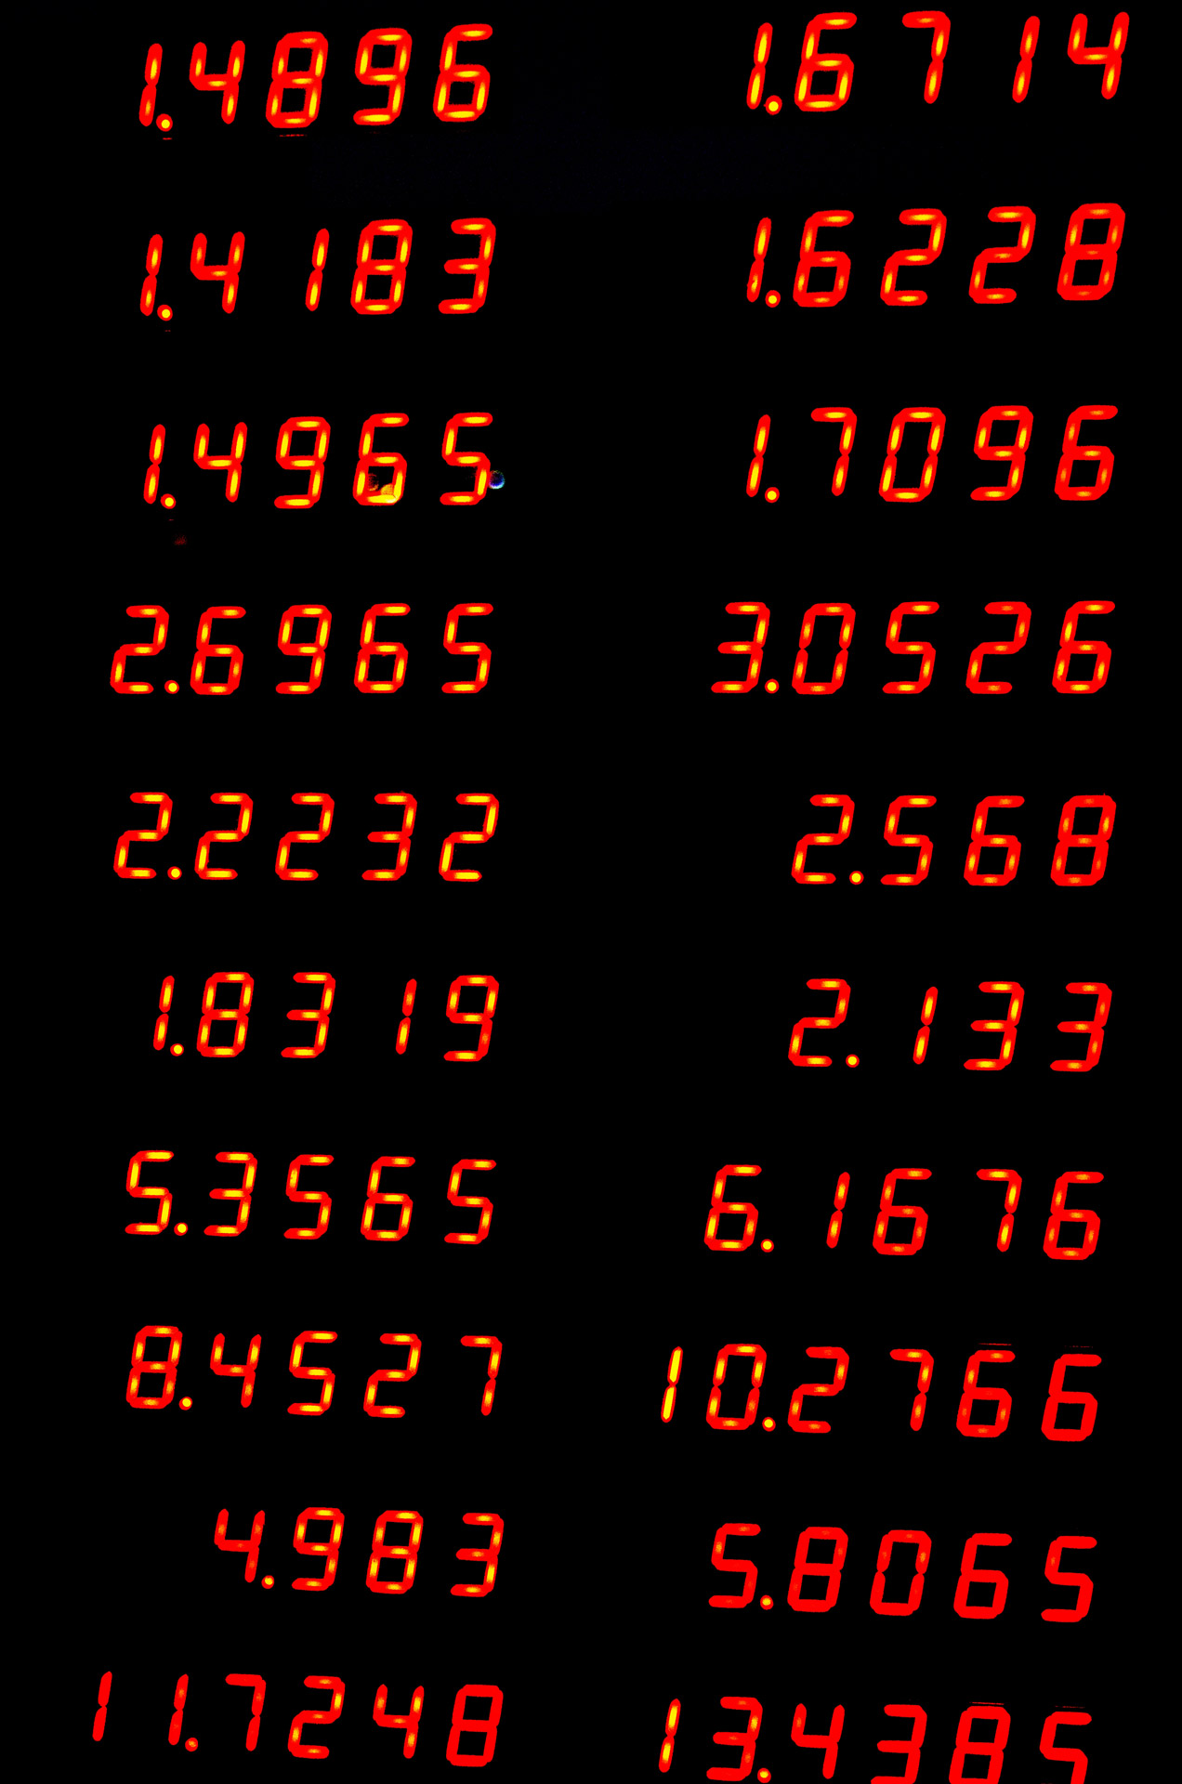
Warm-up: Number Guessing Game
Let’s create a simple game where the computer generates a number between 1 and 100, and the user must guess the number
When the user guesses a number, the program will tell them “too high”, “too low”, or “that’s correct”
The user will continue guessing numbers until they reach the correct number
The program will also keep track of the number of guesses the user uses and will give them a score based on that

Slide 3

Lists Recap
Today we will be learning about dictionaries, which are things in Python that are like lists
In a list, items are organized in order and can be accessed using their index
candy_list = [“Lollypops”, “Candy canes”, “Chocolate bars”]
Lists are useful to store many related variables in one place

Slide 4
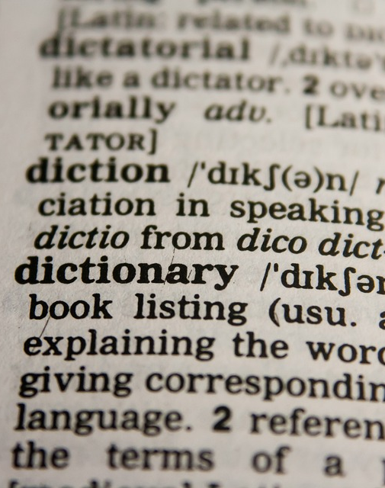
Introduction to Dictionaries
Dictionaries in Python are like lists because they also store a bunch of related variables in one place
Dictionaries in Python are also like dictionaries in real life, which are a list of words that are each connected to their own definitions
For example, a dictionary of coding words might look like this:
Bug: an error in a program
Code: instructions given to a computer
Loop: code that repeats over and over

Slide 5
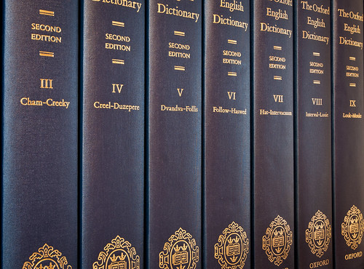
Keys | Values
Bug | an error in a program
Code | instructions given to a computer
Loop | code that repeats over and over
Python dictionaries are easiest to think of like tables with a list of “keys” and their corresponding “values.”
Dictionaries are useful when we’re trying to store pairs of related information
To store pairs of related information using lists, we would have to create multiple lists and make sure they match each other, which would be time-consuming and difficult

Slide 6

How to Create Dictionaries
We create dictionaries in Python like this:
dictionary_name = {
key_1 : value_1,
key_2 : value_2,
key_3 : value_3
}
For example:
coding_words = {
“bug”: “an error in a program.”,
“code”: “instructions given to a computer.”,
“loop”: “code that repeats over and over.”
}

Slide 7
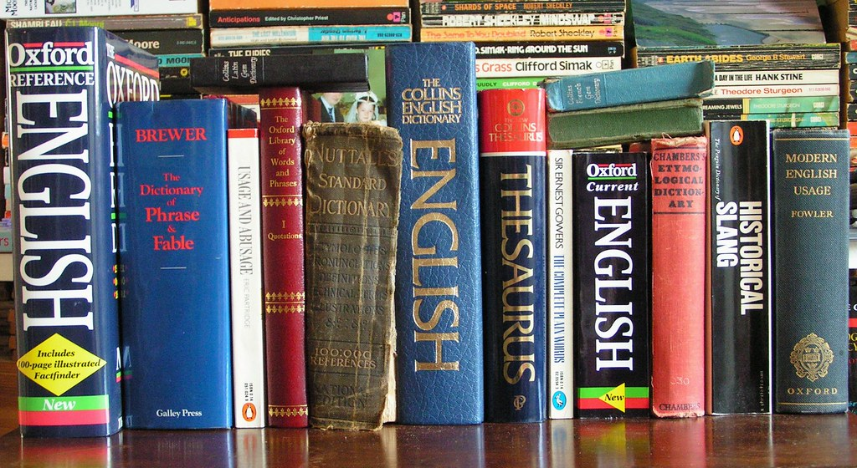
Using Dictionaries
We mainly use dictionaries to access the value connected to a known key
For example, maybe we want to know the definition of code, so we would access the value connected to the word code to print the definition
This might look like this:
print(coding_words[“code”])
Try it out
This Photo by Unknown Author is licensed under CC BY-NC

Slide 8
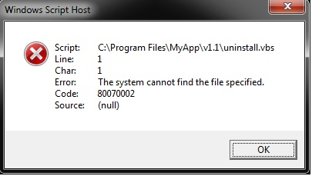
Common Errors with Dictionaries
Some common errors with dictionaries include:
Misspelling the key name
Ex: coding_words[“bog”]
This doesn’t work because there is no “bog” key in the dictionary, so the program gets confused
Trying to access items using their index
Ex: coding_words[1]
This doesn’t work because dictionaries don’t have indexes
Forgetting the “ ” around a String key
Ex: coding_words[bug]
This doesn’t work because the program is now looking for a variable called a bug that doesn’t exist. Strings must always have quotation marks.
This Photo by Unknown Author is licensed under CC BY-SA

Slide 9

Adding New Items to a Dictionary
We can add new items to a dictionary like this:
dictionary_name[new_key] = new_value
For example:
coding_words[“if statement”] = “code that runs only if a condition is true”

Slide 10

Changing Items in a Dictionary
What if we want to change the value of an item in a dictionary?
We can do that like this:
dictionary_name[key] = new_value
For example:
coding_words[“bug”] = “a moth in your computer”
Notice that this is very similar to how we add new values to a dictionary

Slide 11
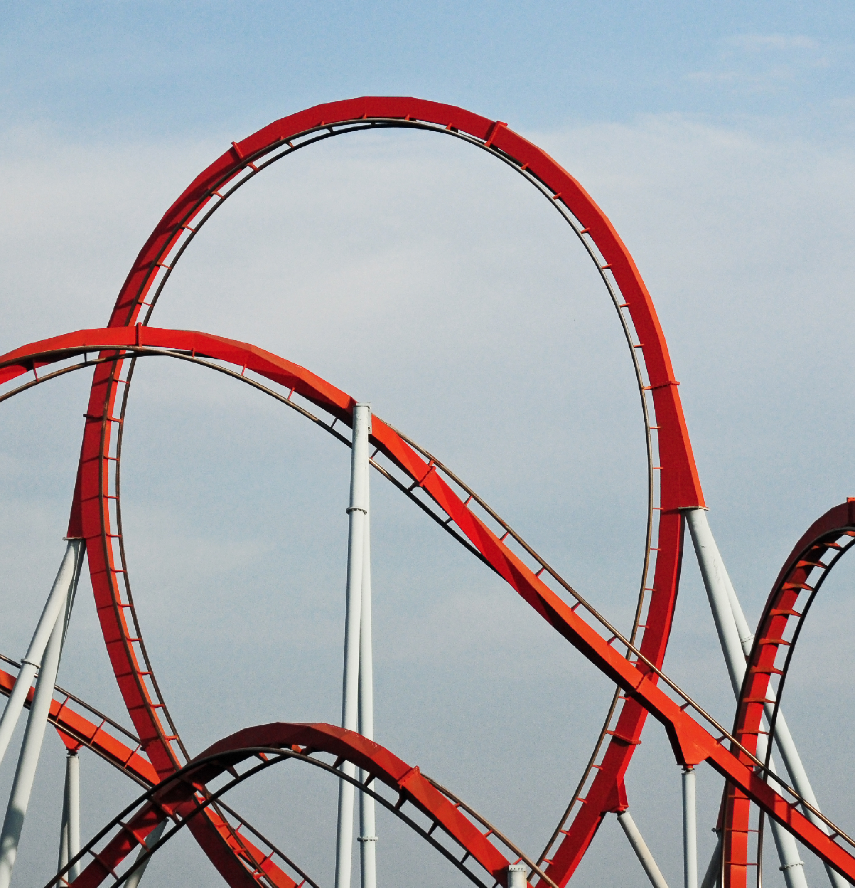
Looping Through a Dictionary
What if we want to access every item in a dictionary?
Unlike lists, dictionaries don’t have indexes, so it’s impossible to use a regular for loop to go through a dictionary
Instead, we can use for-each loops
This would look like:
for item in dictionary_name:
# do this
For example:
for word in coding_words:
print(word)

Slide 12
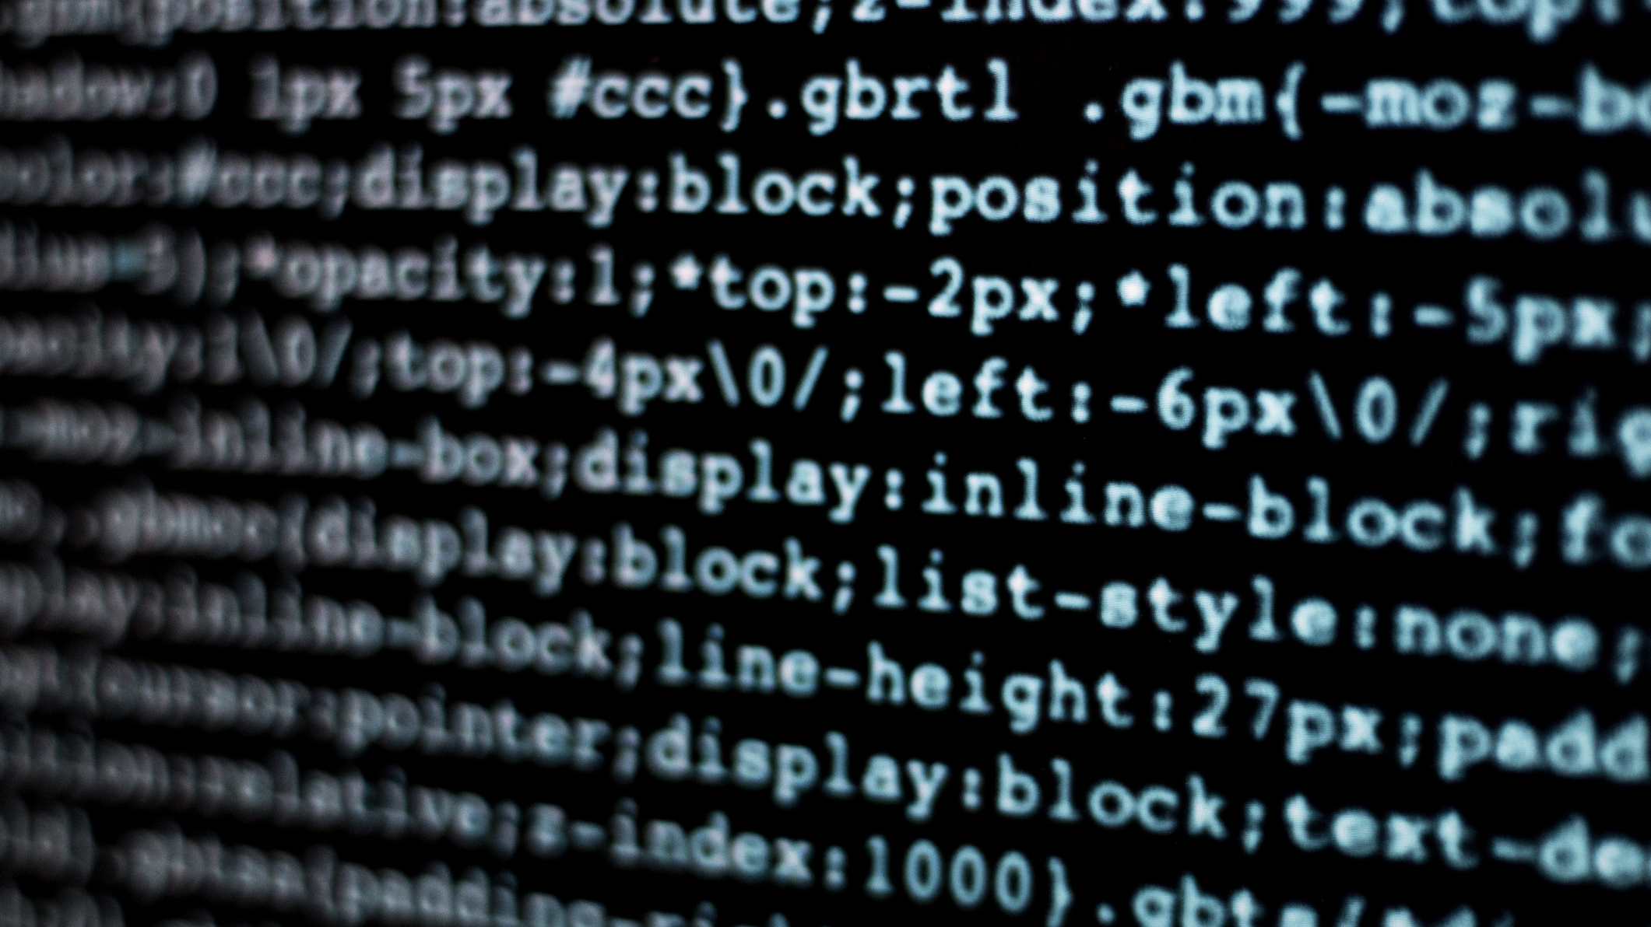
You might notice that if we write:
for word in coding_words:
print(word)
the program only prints the keys, not the values.
If we want to print the values, too, we will have to code something like this:
for word in coding_words:
print(word)
print(coding_words[word])

Slide 13

Empty Dictionaries
Sometimes, we might want to create an empty dictionary so we can add items to it as the program runs
We can do that like this:
empty_dictionary = {}
We can also delete everything in a dictionary by doing this:
dictionary_name = {}
This is useful if we want to do something like get rid of all previous scores when a game restarts

Slide 14
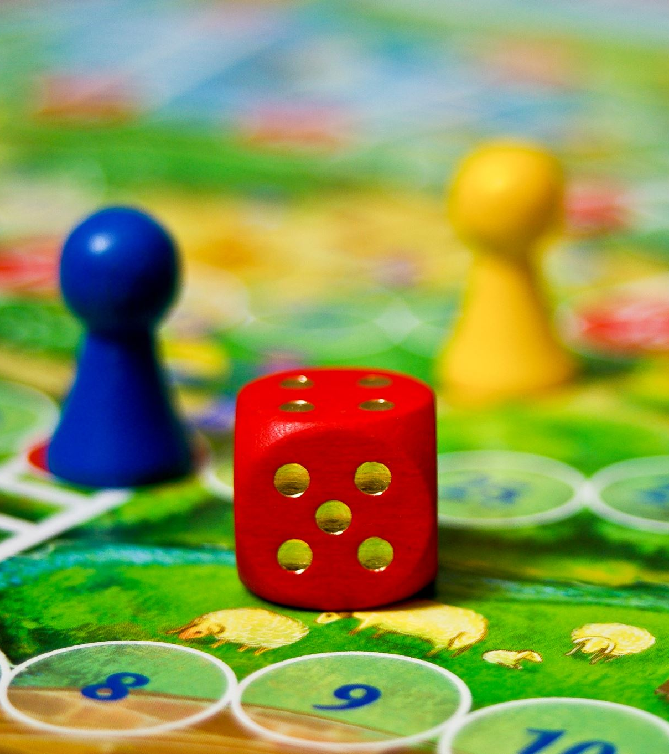
Project: Multiplayer Number Guessing Game
Let’s use what we’ve learned about dictionaries to improve our number-guessing game
Let’s change the game so multiple people can play the game, and after everyone has played, the program compares everyone’s scores
We will need a dictionary to keep track of the players’ names and corresponding scores

Slide 15
def number_guessing_game(): print("Welcome to the number guessing game") print("In this game, you will need to try to guess a random number between 1 and 100") num_players = int(input("How many players are there? ")) player_scores = {} for n in range(0, num_players): print("Give the controls to player " + str(n + 1)) user_name = input("What is your name? ") num_guesses = 1 number = random.randint(1, 100) user_number = int(input("What is your first guess? ")) while user_number != number: num_guesses += 1 if number > user_number: print("Guess higher") else: print("Guess lower") user_number = int(input("What is your next guess? ")) print(str(number) + " was the correct number! You took " + str(num_guesses) + " guesses.") player_scores[user_name] = num_guesses if num_players > 1: print() print("Final scores:") winner = "" lowest_num_guesses = 100 for player in player_scores: print(player + ": " + str(player_scores[player]) + " guesses") if lowest_num_guesses > player_scores[player]: winner = player lowest_num_guesses = player_scores[player] print(winner + " wins!")

